Slide 1
Introducing
3rd Sector Together
Working in North West London

Slide 2
Some key terms
Integrated care system (ICS): In an integrated care system, NHS organisations, in partnership with local councils and others, take collective responsibility for managing resources, delivering NHS standards, and improving the health of the population they serve. ICSs are arranged into three tiers:
System: The partnership operating at the geographical level of the ICS – in our case across 8 Boroughs in NW London
Place: Usually local borough or district level – not clear yet if K&C and Westminster separate or combined
Neighbourhood: The smallest and most local area that services are organised at.
Primary care network (PCN): Collaboration of GP practices covering 30,000-50,000 people working towards integrated primary and community health services.

Slide 3




Slide 4
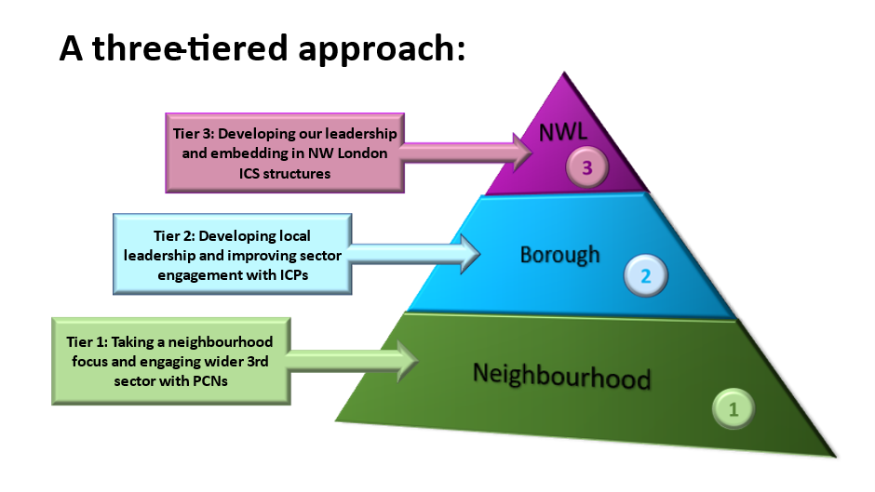

Slide 5
Statement of Intent
3ST has been formed primarily to provide a strategic and commissioning link between the Voluntary and Community sector and the emerging Integrated Care System within the NHS across the North West London region.
We aim to be a strong, recognisable group able to represent the sector’s voice and interests at a local and regional level and to maximise the opportunities presented by the NHS’s Long Term Plan commitment to increased VCSE involvement.
We recognise that the diversity of our sector will mean that not all organisations can commit to full participation at all times. We have developed a series of commitments to ensure that we are able to support all organisations, regardless of size, and engage with our community at all levels.

Slide 6
Governance Principles
The following Commitments have been developed to provide a framework within which the activities, processes and operating principles of 3rd Sector Together sit. The Commitments Framework development work was undertaken with the following guiding principles:
Representation – it is important that all organisations who want to participate are enabled to do so in an accessible way.
Transparency – 3rd Sector Together will develop policies and procedures that ensure that all organisations can access and understand the decision-making processes and outcomes.
Communication – Organisations who participate must be confident that their voices can be heard in everything that 3rd Sector Together does and says.
Fairness – 3rd Sector Together will be careful to consider the impact of activities, particularly income generating, on all members and will establish processes that ensure that member organisations are not unfairly disadvantaged through participation with the Group.

Slide 7
One Westminster will keep everyone informed
through our e-bulletin and this network

