Slide 1
COVID-19 ​impact on Westminster
Health and Wellbeing Network Meeting
Tuesday 25 May 2021
Colin Brodie, Public Health Knowledge Manager
cbrodie@westminster.gov.uk

Slide 2
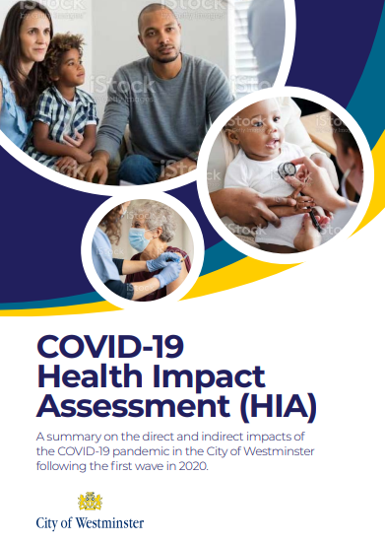
Health Impact Assessment to be published soon
Snapshot from the first wave of the pandemic
Draws on both national and local research and data
Chapters include:
Health and wellbeing
Protected characteristics
Wider determinants of health
Inclusion health
Healthy lifestyle

Slide 3
Key messages
COVID-19 has impacted everyone
The pandemic has had both direct and indirect impacts on the health and wellbeing of residents
Certain groups have been disproportionately impacted by the pandemic
Health inequalities existed before COVID-19
Recovery needs to build on what we know works to address health inequalities through tackling the wider determinants of health
Notes:
Flag deficit/needs focussed but also a lot that is positive – including the role of VCS
North Westminster – Church St, harrow Rd, etc
Continue to monitor the impact of COVID-19

Slide 4
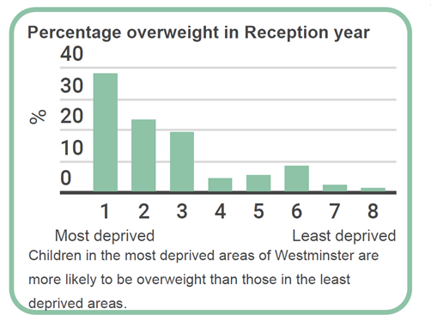
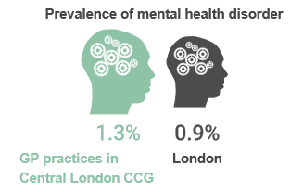
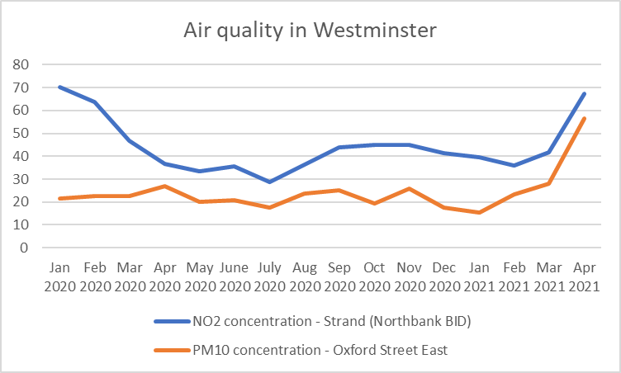
Health and Wellbeing in Westminster
Demographics
The population of Westminster is 259,981, consisting of 135,458 men, 124,523 women and 105,772 households.
Westminster is an ethnically diverse borough. Other than English, the main languages spoken in our borough are Arabic (6%), French (3%). Spanish (2%), Italian (2%)and Portuguese (2%)
Child health
Westminster remains below the London average for Obesity at Reception level (21.2% of children classed as obese or overweight, London: 21.6%).
However there have been high levels of obesity of Children in year 6. (41% of children classed as obese or overweight, London: 38.2%)
There is a high % of children with one or more decayed, missing or filled teeth (30.3%, England: 23.3%).
General Health & Wellbeing
87% of people in Westminster think they are in good health according to the City Survey 2018/19 which is a 3% increase from 2016/17.
Wider Determinants of Health
There have been 2,757 rough sleepers in 2019/20 which is 10% higher than 2018/19, of which 64% were seen as new rough sleepers.
The unemployment rate is 4.3%, with 759,000 jobs and a median household income of £47,510.
Mental health and wellbeing

Slide 5
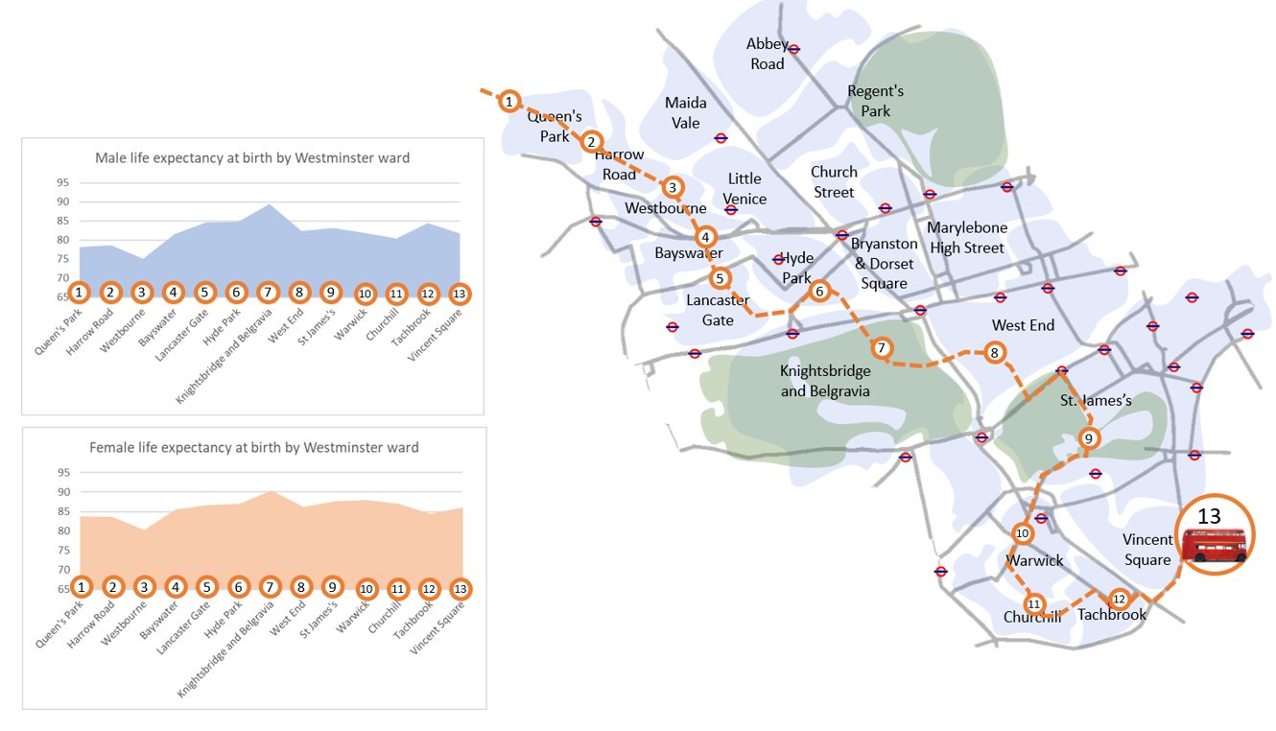
Background
Life expectancy is one of the key measures of health inequalities. Many of our residents live long lives, with some of the longest life expectancy in the country. However, there is also significant variation in life expectancy within the borough. This map shows that as you travel across Westminster, the life expectancy for residents fluctuates, depending on where you live. This reflects the variation in health between the most and least deprived parts of our boroughs.
Health inequalities existed before COVID-19​. For example, the life expectancy of a baby born in Queen’s Park is 78.2 years, compared to a baby boy born in Abbey Road where life expectancy is 86.8 years​.
COVID-19 has exposed and exacerbated existing inequalities.
​
Source: Public Health England (PHE) Fingertips, 2013-17

Slide 6
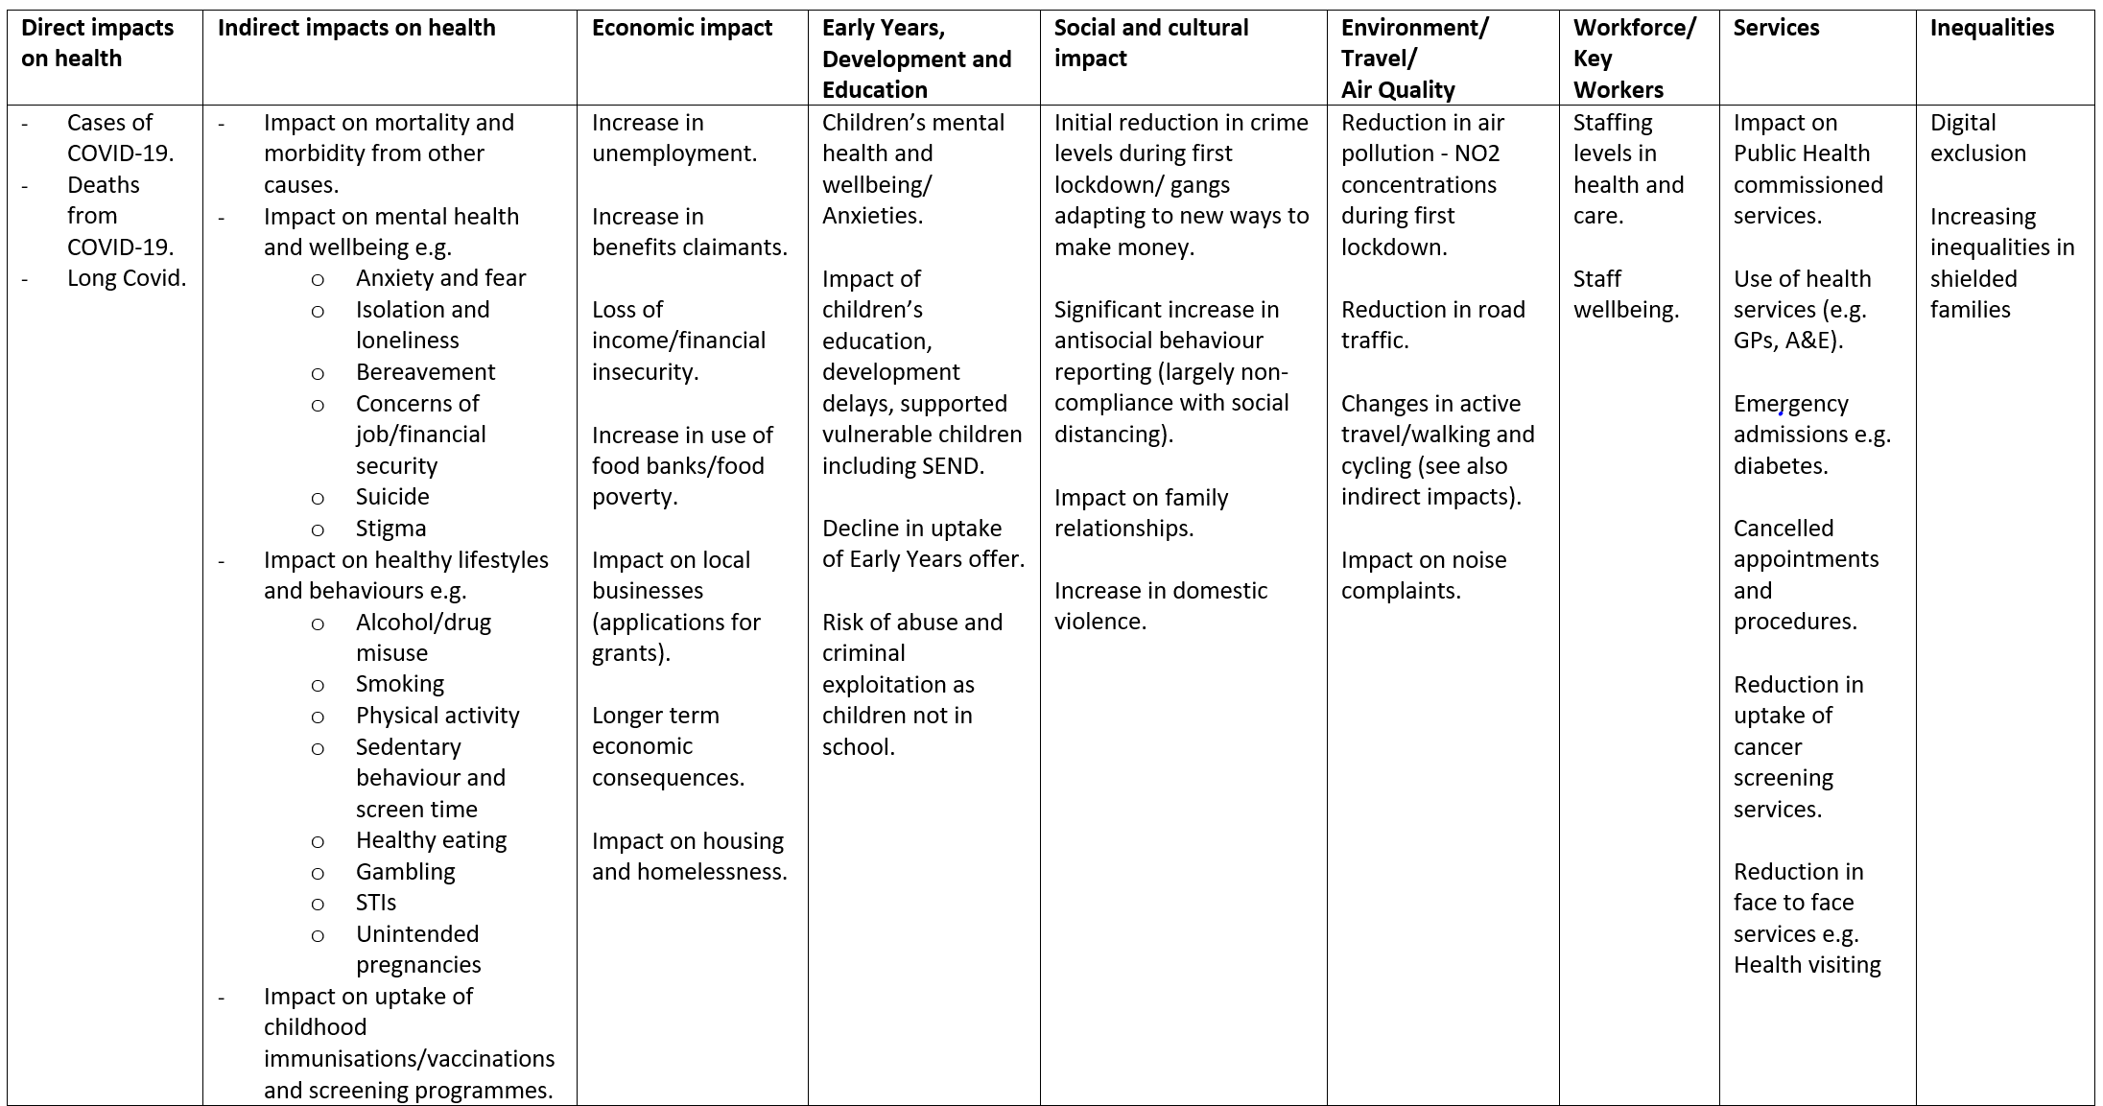
How has COVID19 impacted on health and wellbeing?
COVID-19 has impacted all aspects of life. The table below highlights some of these impacts and the initial horizon scanning which informed the scoped of the analysis.

Slide 7
What does the Health Impact Assessment tell us?
Health and wellbeing
Cancer screening services were paused across England and urgent referrals to services dropped,
People with conditions such as diabetes or respiratory disease more at risk from COVID19. Local prevalence of diabetes and COPD is lower than the London and England average but varies by ward and ethnicity
COVID19 has impacted mental health and wellbeing, with Westminster already having a higher prevalence of common mental health disorders in 16+ year olds (18.7%) and over 65s (11.6%) than the England average (16.9% and 10.2% respectively). For 65+ year olds this is also higher than the London average (11.3%).
Inclusion health
Homeless people are more at risk from COVID-19 and have a lack of access to basic facilities that would enable them to reduce their risk e.g. by self-isolating or washing their hands
There has been an impact on carers mental health and wellbeing, and they are at risk of ‘burnout’ and increased sense of isolation
There could be an increased risk among people who use drugs due to higher levels of comorbidity. Sharing drug using equipment may also increase the risk of infection
Internationally, refugees and vulnerable migrants could be at heightened risk of adverse impacts from COVID-19 and lockdown measures due to their ethnicity, pre-existing conditions, poor mental health and wellbeing, lack of knowledge of the healthcare system and support networks, language barriers, and lack of access to technology
Wider determinants
The number of people claiming out-of-work benefits from January to August 2020 more than doubled in Westminster from 3785 to 9905.
Young people aged under 25, women, and low earners are more likely to work in sectors most affected by lockdowns
Risk of homelessness is likely to increase nationally due economic downturn following the pandemic due job losses, financial insecurity, rising personal debt levels
There has been an increase in demand for domestic abuse services
Local analysis indicates an increase in the percentage of deaths in the most deprived areas during the first wave, compared to the previous year.
Protected characteristics
Local analysis has supported national research that older people and men are more at risk of dying from COVID-19. 85% of residents who sadly died were aged 65+ and 60% were men.
Similarly, initial analysis supports national evidence there has been a higher rate of deaths among people who identify themselves as being from a Black, Asian or minority ethnic background.
There is potential for a significant longer-term impact on children and young people with disruption to education and disproportionate impact of unemployment on young people
Nationally, disabled adults were more likely to report being very worried about the effects of COVID19 than non-disabled adults in the early part of lockdown.
Healthy lifestyles
Many smokers across the country have taken the opportunity to reduce or quit during lockdown. Prior to the pandemic the borough had the 5th highest smoking quit rates in the country
Nationally, lockdown has had a negative impact on health behaviour such as diet. Obesity prevalence, which we know nationally is higher in deprived areas, may be impacted.
National research suggested people were walking and cycling further during lockdown. However, locally, people reported not going out at all and not letting children out, with physical activity dropping completely for many residents

Slide 8
Key messages and commitments from HIA
Key messages
COVID-19 has impacted everyone
The pandemic has had both direct and indirect impacts on the health and wellbeing of residents
Certain groups have been disproportionately impacted by the pandemic
Health inequalities existed before COVID-19
Recovery needs to build on what we know works to address health inequalities through tackling the wider determinants of health
Committments
Focus attention on areas and communities with the greatest needs.
Ask residents about their health and wellbeing to direct our efforts.
Innovate by codesigning campaigns and actions to bring us closer to the communities we serve.
New investment in transformational programmes to address health inequalities

Slide 9
Any questions?
Do the findings sense-check with what you have seen in the community?
What do you think are priorities for health and wellbeing as we go forward into recovery?
How can we work with you to understand more about the impact of COVID-19 on residents and communities in Westminster, and how best to co-design the solutions?

Slide 10
Thank you! Colin Brodie Public Health Knowledge Manager cbrodie@westminster.gov.uk

