Slide 1
In - Partnership:

Slide 2
Patients / Residents received a Social Prescription April 2020 – April 2021
Gender | Percentage
Trans | 8%
Female | 52%
Male | 40%
Virtually and F2F – 1,189

Slide 3
Lay of the Land
A small flexible and responsive VCS provider base – exceedingly agile and meeting needs of residents.
Well stocked community – at what cost?
Gaps to fill – Working age men Mental Health, decluttering, Housing support (statutory) , better communication between the agencies.

Slide 4
Health Professionals to Social Prescriber.
“This lady has it really tough with a son with severe autism and behavioural needs, she struggles with anxiety and feels that none of her friends understand. She has a very supportive husband. Do you know of any parent support groups for families dealing with an autistic child as I think she could do with talking with other mum's who understand what she is feeling.”
“I just spent a very long time talking to this retired Catholic priest about all aspects of his health. His work was so central to who he was and, since retiring and lockdown he is v lonely. Can you seeing if you can find any outdoor social activities for him? He's hard of hearing so telephone consultations are quite hard work.”
“Lucy is 48 yr old single woman with few friends and no family in London. She has been extremely isolated in lockdown and her mental health has suffered. the one thing she enjoys is TV -is there any kind of interest group that she could join for that? She also walks her dog every day so doing it with someone else might be good....”
“This family apparently have been referred to a Westminster charity but not appearing to have anyone call them, they could really do with some support with housing as it is the social situation which is really impacting on the ability of the day to relax and get rest and improve in his health and mood. Arabic Speaking SP may be ideal to be a link for them. Could shelter be useful as they are really struggling to fill in the forms?” “She is a 40 year old local resident who has a long standing issue with low mood. More recently due to covid she has been placed o furlough and is now unsure if she will be made redundant This has obviously made her feel in limbo and has some financial implications which are impacted on her mood. In addition the lack of work has meant she has lost all structure and routine to her days with loss of motivation.”

Slide 5
“Two parent family with 4 children age 8, 2 and 8 months and 11 months old twins. 1 bed flat. Children have no bedroom room of their own to sleep in or space for play and stimulation. In the past, I referred to a Westminster Charity where they were allocated an outreach worker, but somehow father informed me that he only made contact once or twice. Their father has significant health problems and the housing situation is adding further stress to family.”
”She is feeling very very anxious - I'm going to give her a self referral to psychology services, she needs to be encouraged to re-engage in exercise, she is praying much more (muslim) and would like more guidance as holding on to lots of past regrets - she doesn’t have any other hobbies, lives with her mum who is unwell. she has consented to you calling”
“Bengali speaker + High Anxiety & Worsening BP + Struggling to engage with work, finding suitable Bengali psychological support”
“I have a 52 year old lady who has bowel cancer, it is not curable but she is likely to be still offered some chemo. She is pretty unwell and has recently moved into the area and appears to have very little support from friends or relatives as her husband has already died several years ago. She says she would really appreciate some telephone befriending.” (Befriender/ Food Bank/ Regular Wellbeing Chat / Money Management VCS org)
“I was wondering if you could review this patient. she is privately renting and currently having relapse in her mental health as the ceiling collapsed due to work the landlord is doing above. Currently scared to stay in the flat as worried something will happen.” (SP – Connect with VCS org to speak with Landlord, Coaching..)
“He could do with some legal aid/ support - advocate. Victim of torture but has gone from being very wealthy and able to after torture and escape and helping family members start a new life, seeing his physical and mental health suffer and financially now crippled. Feels like he wants to die. He is under psychology. We need to find something that he will engage with used to love singing. If we can help with the legal stuff that would be a start.” (Asylum Aid / Virtual Choir – explored other interest)

Slide 6
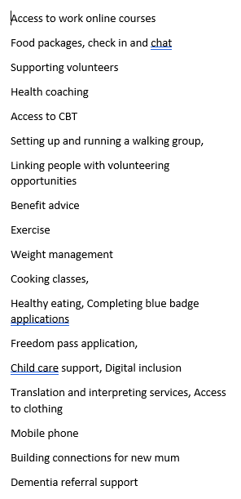
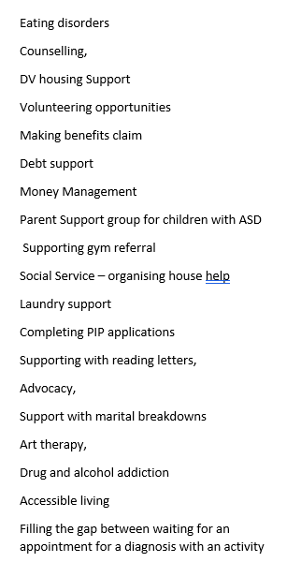
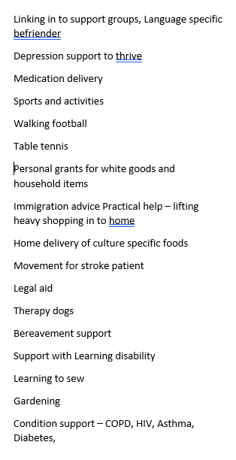
Main supported needs

Slide 7
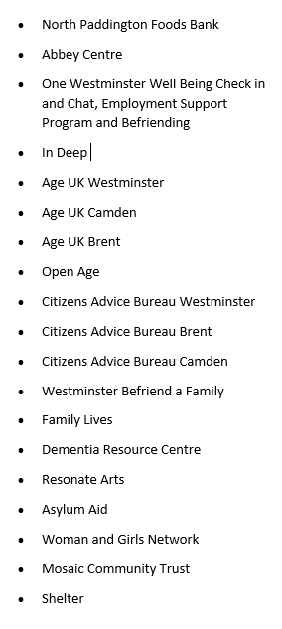
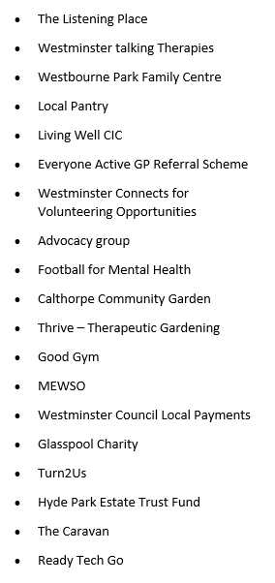
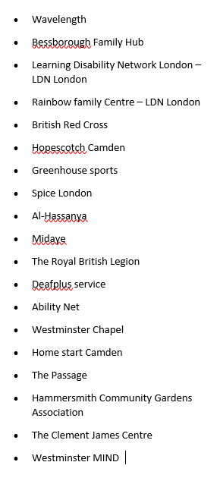
Celebrating a Well-stocked Community

Slide 8
Less able to help with
Stopping working men access to communal area to fix window
Escalating repairs with haste
Over 70 – Informing the GP of activities to support the patient in the VCS.
Access to money but not to trusted house help
Housing – private/ council / housing association/ temporary

Slide 9
Questions

Slide 10
Contact
Concia Albert – Head of Social Prescribing c.albert@onewestminster.org.uk
www.onewestminster.org.uk
Westminster, London

